Slide 1

Physician, heal thyself - healthier hiring for digital government

Slide 2

You are listening to
Jenny & Jukesie
Notes:
JENNY A bit about us and why we might be worth listening to on this particular story

Slide 3

Notes:
JENNY I’m Jenny, I work for the National Leadership Centre. I’ve just finished a huge round of recruiting, to staff the whole centre, and before that I was hiring and community building for the Digital Team at the Department for Education. I’ve been a Civil Servant most of my career, generally in jobs thinking about people and strategy. Most of my frame of reference comes from hiring for digital and other roles within government, though I also did some hiring while working as a technology consultant.

Slide 4
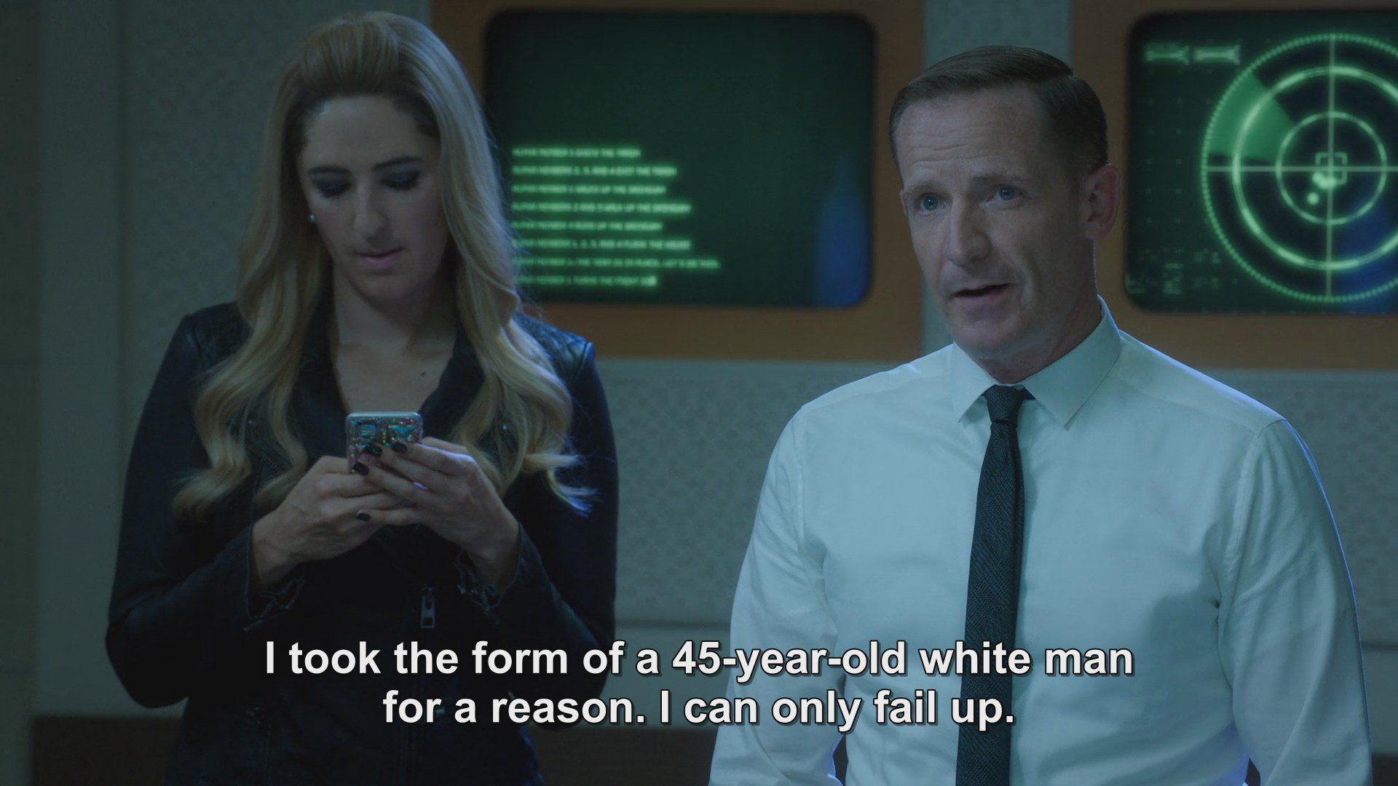
Notes:
I’m Jukesie...

Slide 5
Hypothesis
Symptoms
Treatment
Follow-up
Notes:
Jukesie

Slide 6
Hypothesis
Symptoms
Treatment
Follow-up
Notes:
Jukesie

Slide 7
We need to design hiring with the same care we design services
Notes:
JENNY We are all here at this conference talking about how we design services. We talk about inclusion, service standards, sensitive user research - and it all applies to building your team too. And we need to get it right to be able to do the job.

Slide 8
Most of government is mostly service design most of the time

Slide 9
Most of government is mostly service design most of the time

Slide 10
Most of government is mostly hiring most of the time

Slide 11
The biggest digital transformation challenge is people not technology.
Us.
Notes:
Jukesie

Slide 12

Hiring the best is your most important task.
Steve Jobs
Notes:
JENNY Think about a group of ants making off with a sandwich. Hire the right people and you can move mountains.
I mentioned that I’ve just started a new role, setting up a new organisation. The biggest contribution I can make to the direction of our work is to hire the right people. These people will decide your strategy, deliver the work, be the face of the team, and really importantly, you’re going to spend a lot of your time with them. You can’t do it all yourself so it’s in your interests to work hard at getting this right.

Slide 13
Hypothesis
Symptoms
Treatment
Follow-up

Slide 14

Start with a couple of horror stories
Minimum text size 36pt
Your Twitter Handle Here
Notes:
Jukesie

Slide 15
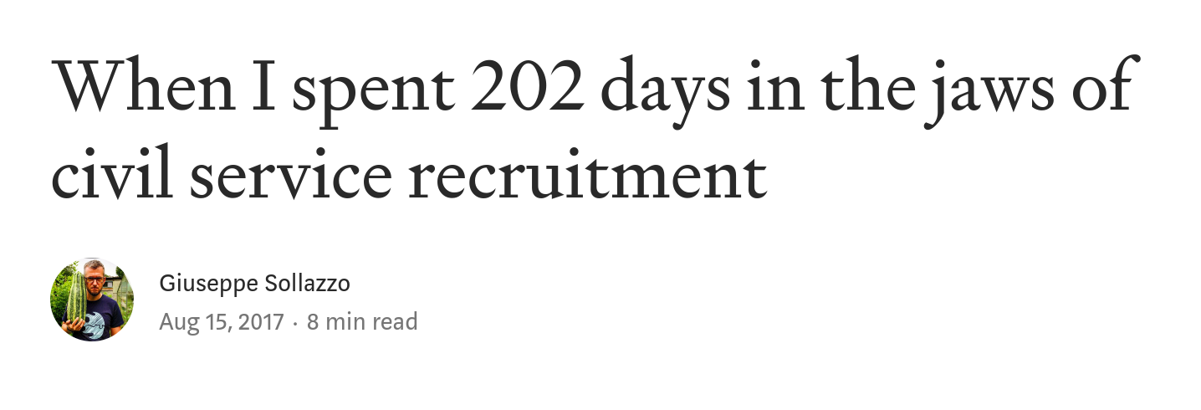
Notes:
Jukesie From start to finish the Cabinet Office says it will take you 100 days minimum to hire someone, longer if they’re external and have a notice period (assume three months) and clearance is longer still.
JV CHECK CO GUIDANCE
[I have someone recruited in September who still hasn’t passed clearance. Though that’s not the norm]

Slide 16
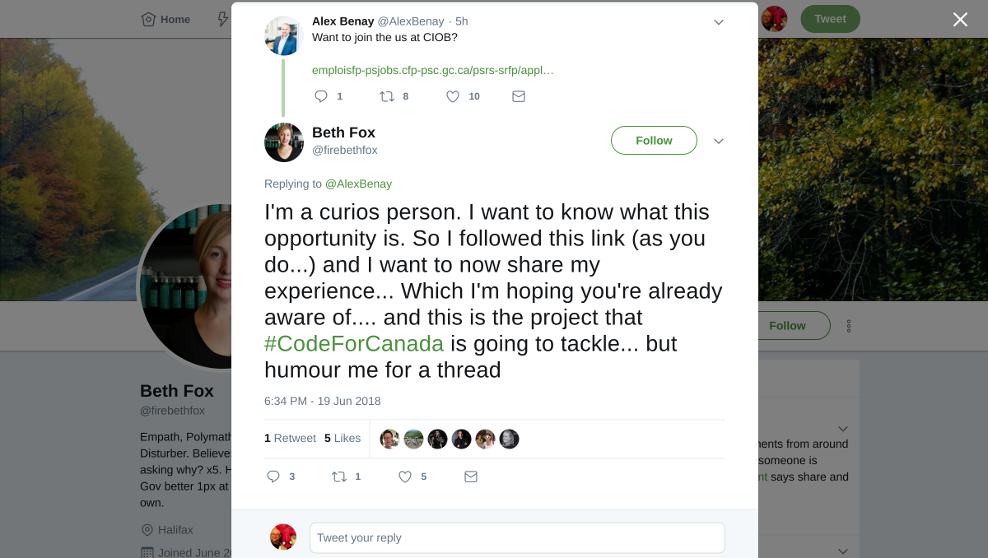
Notes:
Jukesie

Slide 17

Growing fast
Photo by Hello I'm Nik on Unsplash
Notes:
JENNY I think we’re all aware that the expertise that is covered by the digital profession in government is growing fast.
If we look at some of the stats...

Slide 18
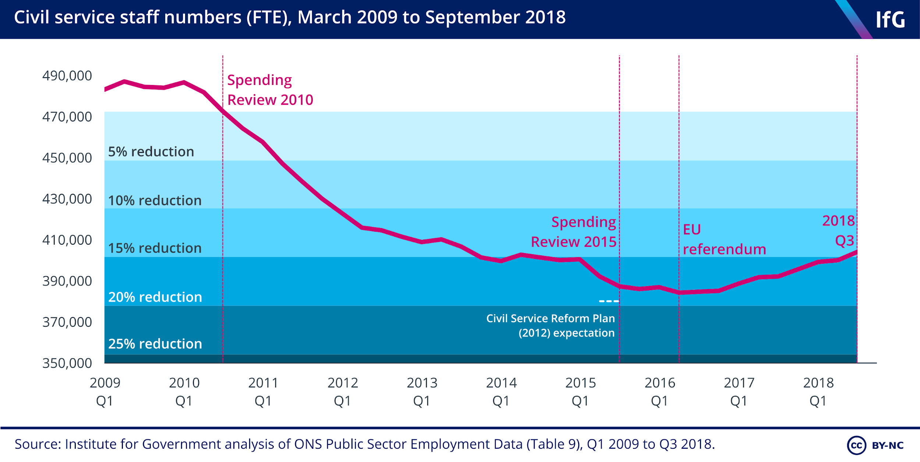
Notes:
JENNY The Civil Service has been deliberately shrinking until recently ahem let us say the workload increase

Slide 19
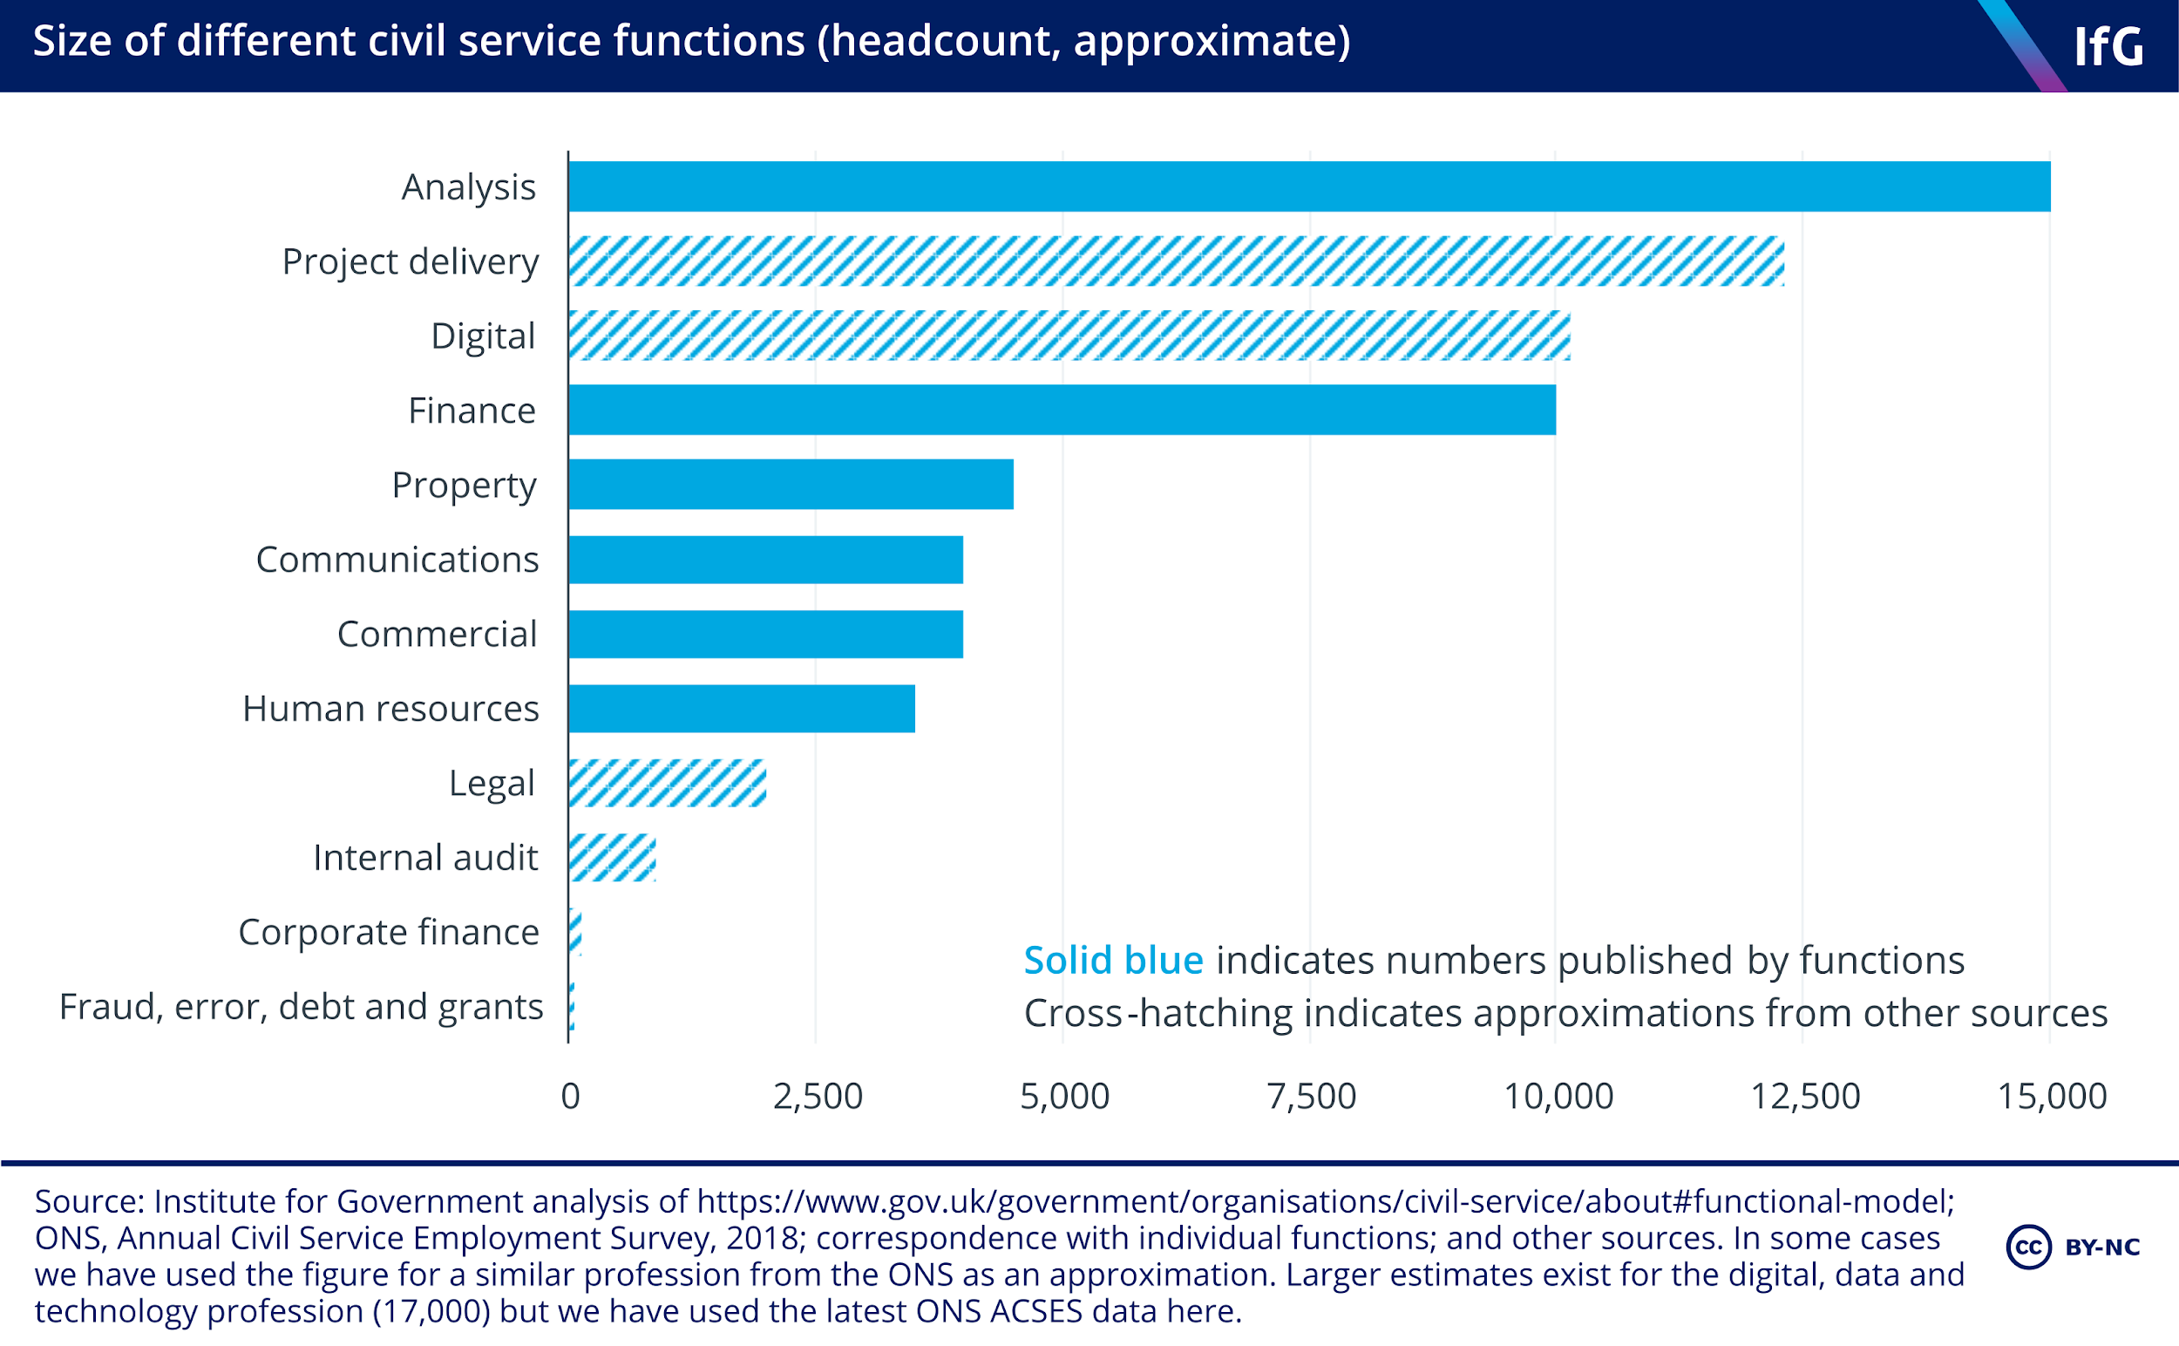
Notes:
JENNY And if we look at this, the digital profession is now a really large proportion, and the stats in the small print actually point out that if you take the digital, data and technology profession then we’re looking at 17000

Slide 20
Notes:
JENNY So ahem, I made a little edit

Slide 21
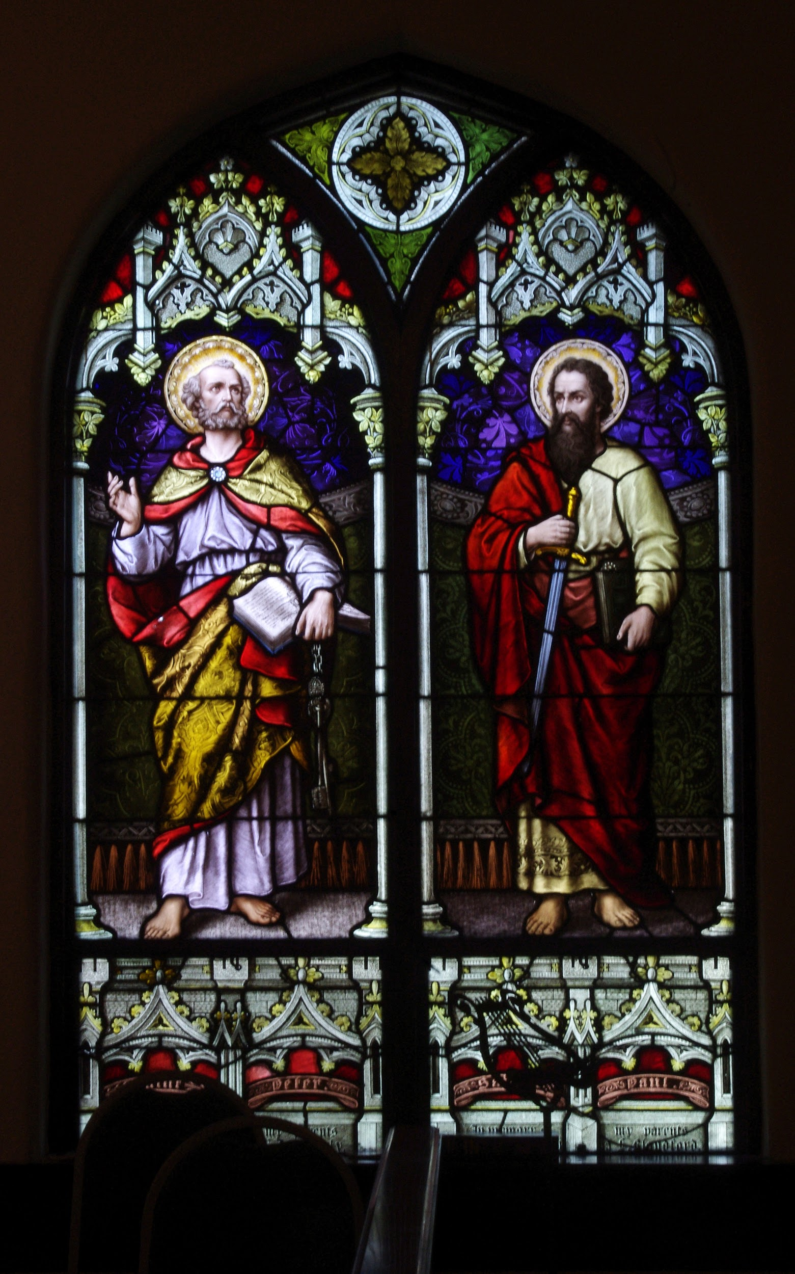
Rob Peter to pay Paul
Notes:
Jukesie We know there’s a lot of movement in the Civil Service [stats] and recent moves to support Brexit have only reinforced that.

Slide 22
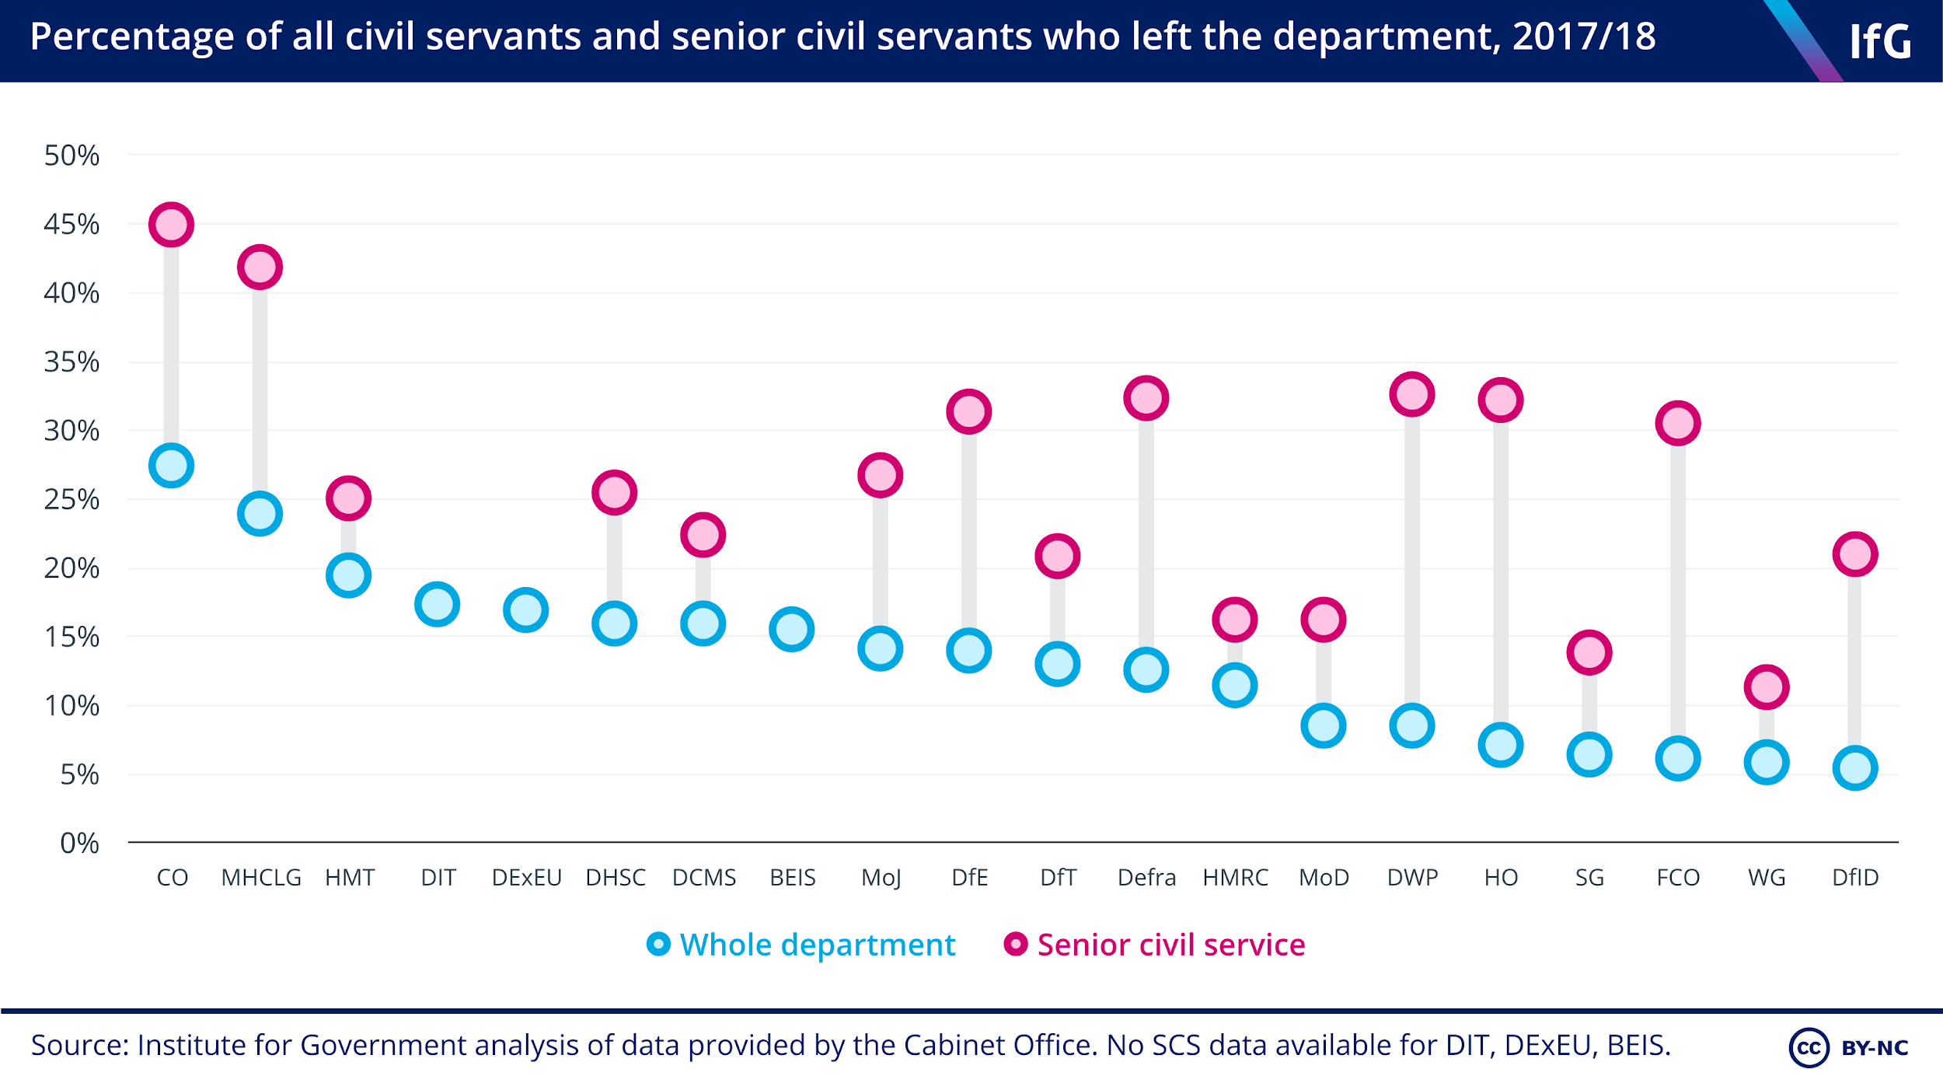
Notes:
Jukesie

Slide 23
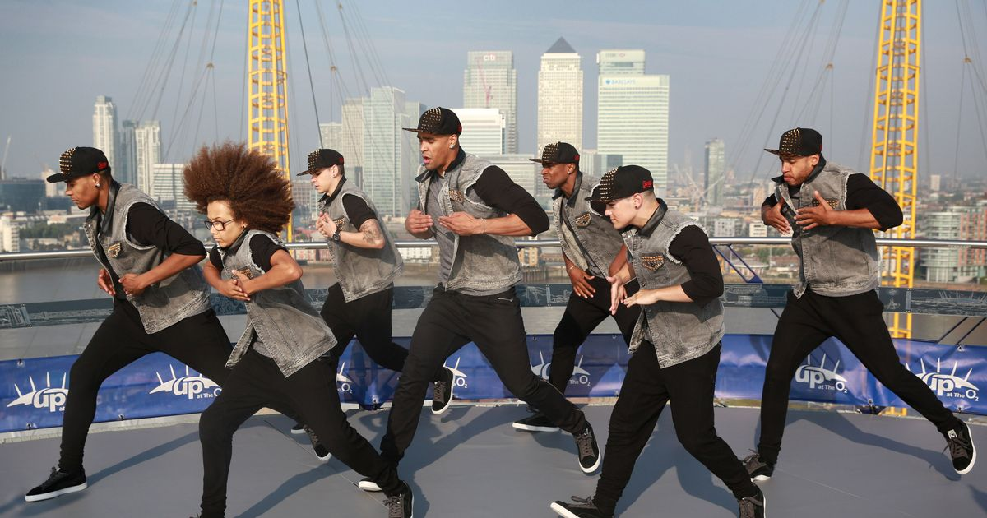
Lack of diversity (in all aspects)
Minimum text size 36pt
@jennyvass
Notes:
JENNY I was watching Nanette last night. You haven’t seen Nanette? Hannah Gadsby on Netflix. Go watch it.
She’s flipping excellent. And the quote I’m going to borrow is
“diversity is strength. Difference is a teacher”
We’ve all seen the running jokes. The apple health app that didn’t have anything about periods because there were no women on the team …. etc
Good outputs need diversity of thought, of experience. And this is why you cannot hire mini-mes.

Slide 24
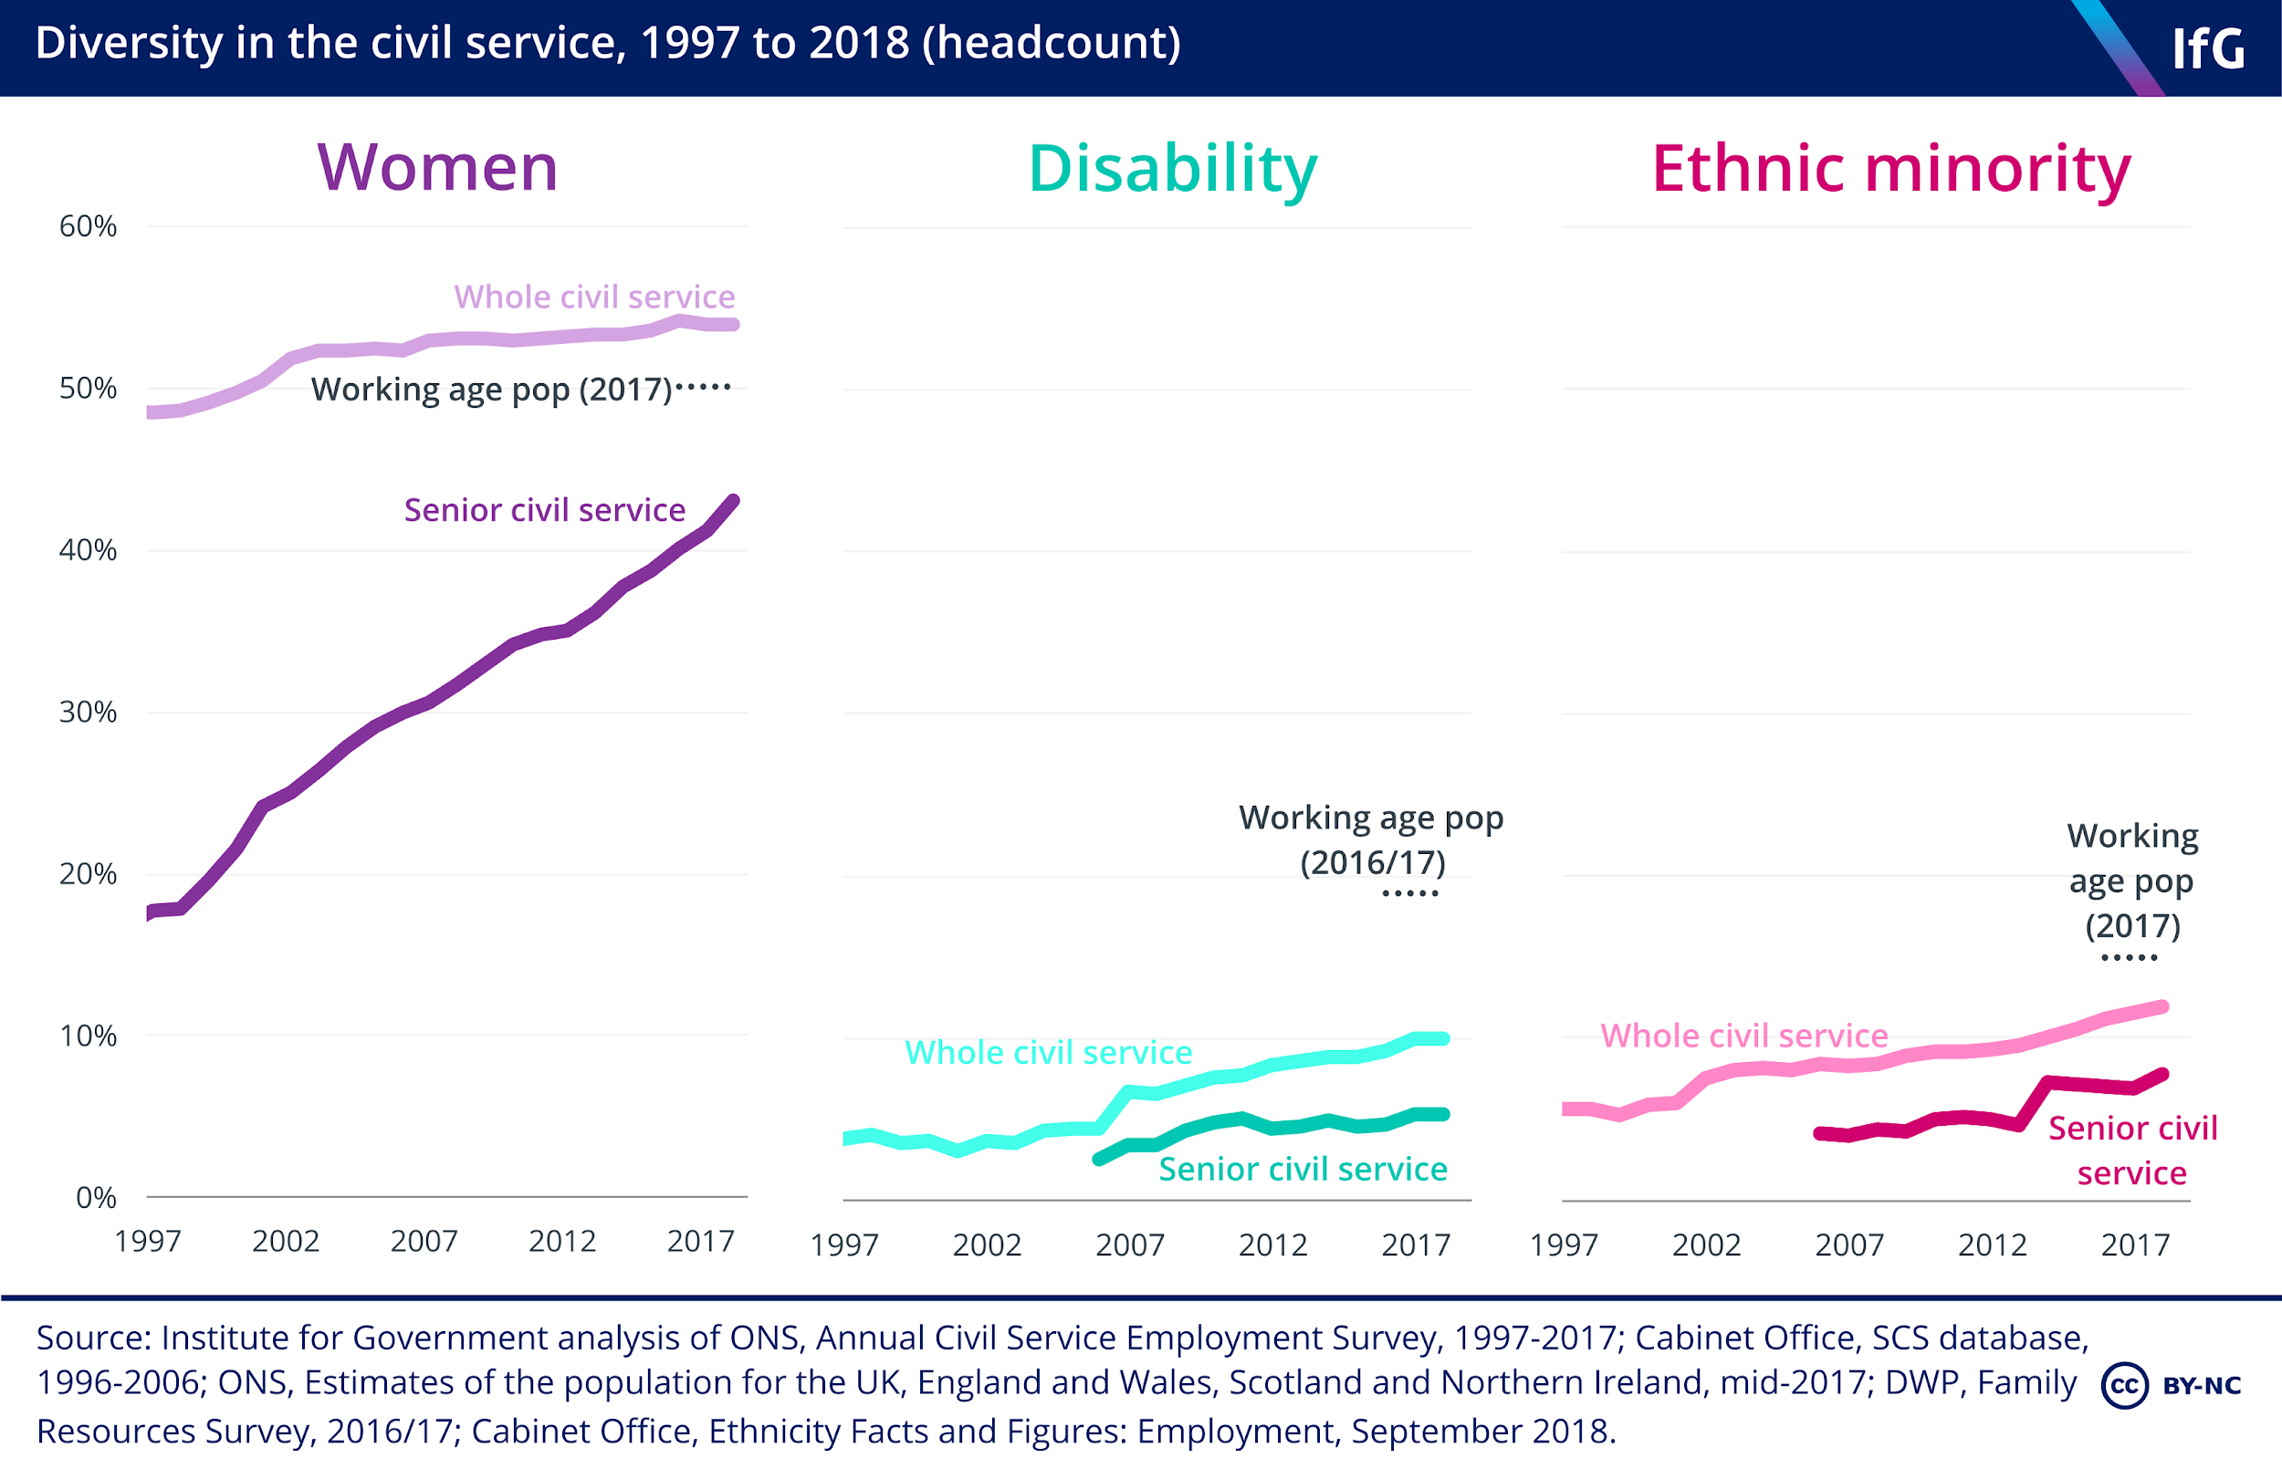
Notes:
JENNY We’re talking about it and we’re getting a *bit* better. But I’m afraid my answer is pretty much always “try harder”.
Socioeconomic backgrounds?

Slide 25

What is getting in the way of doing things better?
What are the..
Minimum text size 36pt
Your Twitter Handle Here
Notes:
Jenny so what stops us?

Slide 26

Bad systems
@jennyvass
Notes:
JENNY I could talk for weeks about the Civil Service Jobs site, and how the system limits you. There’s a 48hr delay between asking a question and getting a response. Not 48hrs to fix it, but 48hrs to respond to you. All your responses to interview etc must be uploaded before anything can be progressed. Which means when you have 140 people to reply to or 30 interviews to do, it delays you making an offer.

Slide 27

Hiring as a side hustle?
@jennyvass
Notes:
JENNY Like many jobs, I was passed hiring as a side project. Most of us who recruit in government are team managers who then have a space in their team they need to fill.
I didnt have to have any qualifications in it. It happens that I’ve got a HR Degree, but that was coincidence. We are quick to see hiring as something anyone can do, and while it’s true that anyone can do, its not an unskilled job. There are plenty of mistakes I’ve made along the way.

Slide 28
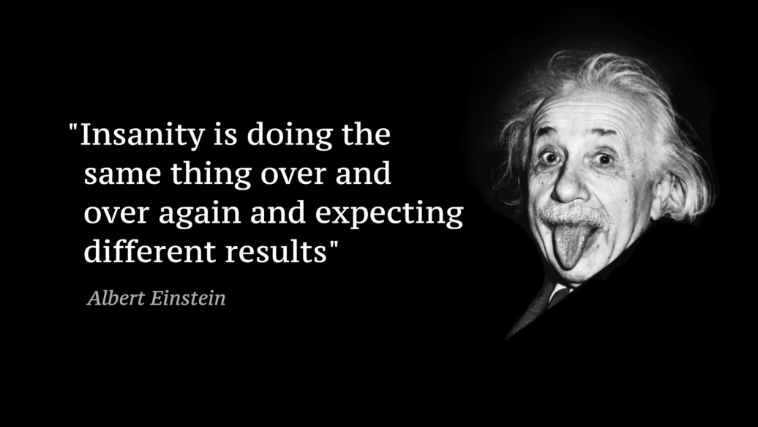
Are we just repeating the same old?
Minimum text size 36pt
Your Twitter Handle Here
Notes:
Jukesie We often recruit when we’re stretched for time, aren’t dedicating time to it and use the same patterns as before…

Slide 29

@jukesie
Notes:
Jukesie Now, this is one area I actually think we’re getting much better.

Slide 30
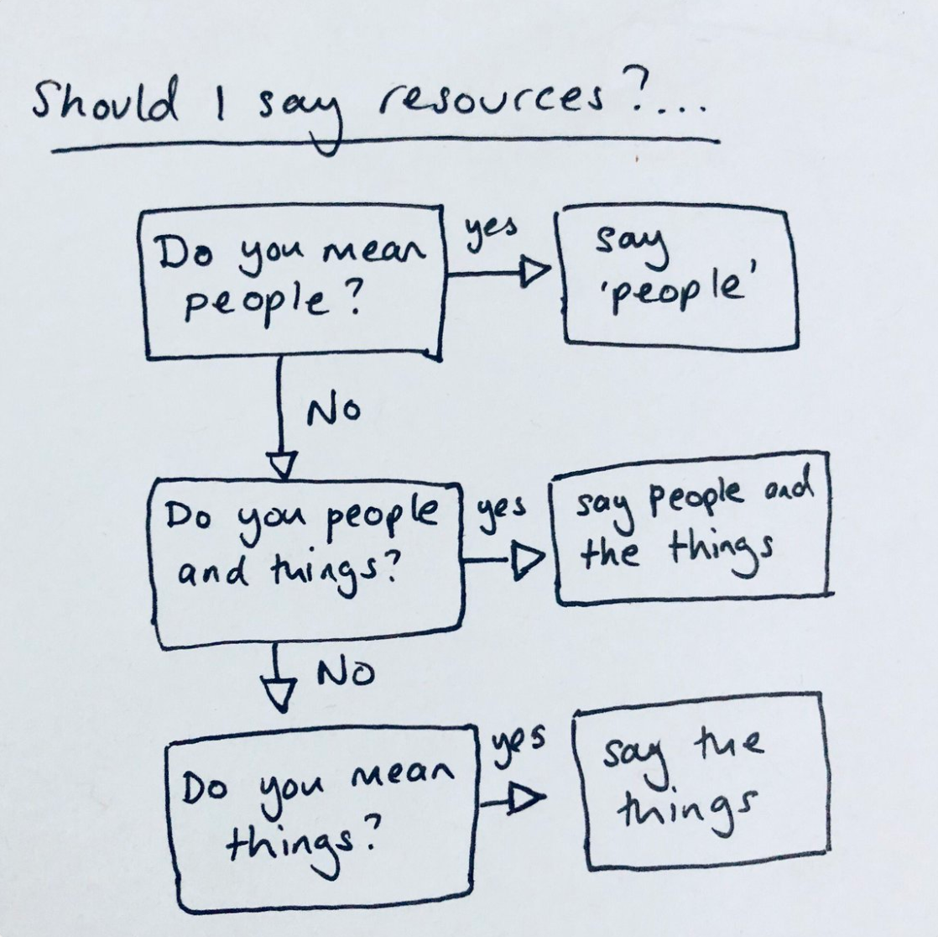
Emily Webber
emilywebber.co.uk
Notes:
Jukesie

Slide 31
Hypothesis
Symptoms
Treatment
Follow-up

Slide 32
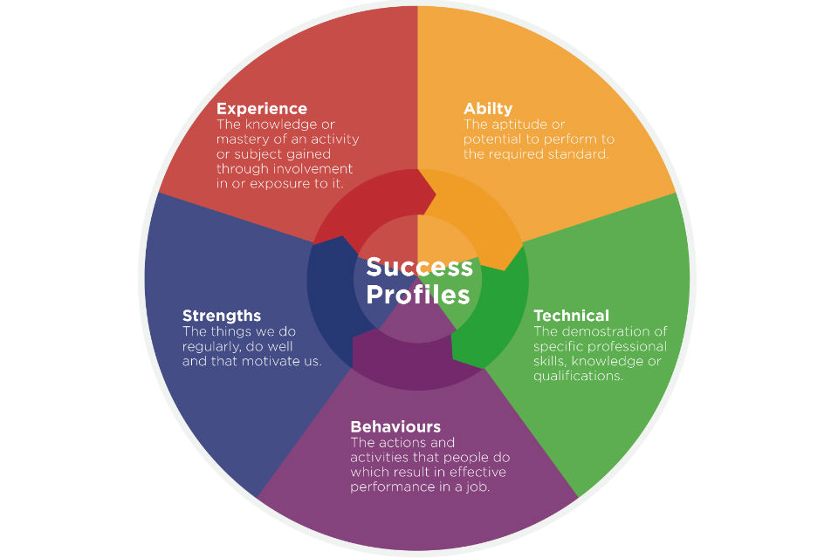
@jennyvass
Notes:
JENNY First up, there’s some good news….
When I did my HR degree the Civil Service Competencies framework was hailed for its equality, but we know it was loved and loathed in equal measure. Whilst it was fundamentally hugely fair and equal; if you understood the mechanism you could see exactly what you would get points for, but in practice it became a performance of telling stories to fit competency frameworks. And when I started hiring for digital roles I realised it was completely impossible to ask digital specialists to perform to these patterns. We got round it by interviewing on the basis of CVs and Skills. Since last year the system has changed and now allows you to test five different areas, including specific skills tests and asking about relevant job experience. This should help a lot for digital roles, but it also does something interesting by letting you test for strengths - preferences and abilities that don’t necessarily come out of performative interview questions.

Slide 33
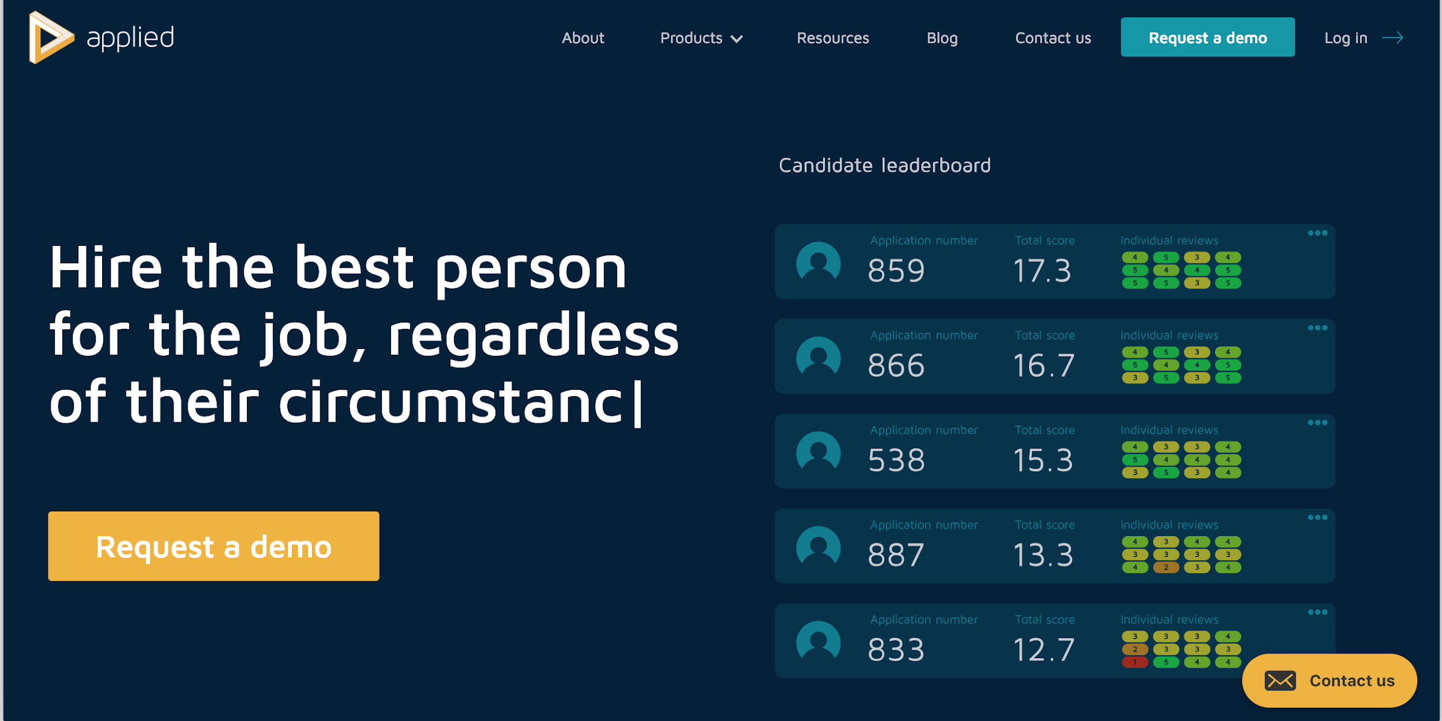
@jennyvass
Notes:
JENNY There are better tools out there.
Be Applied is a good example
It was designed by the Behavioural Insights Team to remove biases from hiring.
They’ve also got a job description analysis tool.
Gendered language detection, readability scoring, analytics on your scorers…

Slide 34
Challenge your assumptions
When you first sit down to think about jobs, what do you really, genuinely *need*?
@jennyvass
Notes:
JENNY Are you hiring with a certain shaped person in mind?
First rule of not hiring to biases is challenge them
Do you really need to be co-located?
What is genuinely an essential skill?
Slim the requirements right down to open up the field
Slim it right down so people put themselves forward

Slide 35
Know your biases
It’s not just about clicking through Unconscious Bias training
@jennyvass
Notes:
JENNY Affinity bias, Halo effect, Attribution substitution…

Slide 36
Ask the community for help.
Draft job descriptions on Hackpad. Twitter polls on job titles. Feedback on interview processes.
@jennyvass
Notes:
JENNY

Slide 37
Ask the team for help.
Draft job descriptions on Hackpad. Twitter polls on job titles. Feedback on interview processes.
@jennyvass
Notes:
JENNY

Slide 38
Ask the suppliers for help.
Draft job descriptions on Hackpad. Twitter polls on job titles. Feedback on interview processes.
@jennyvass
@jennyvass
Notes:
JENNY
ASK FOR HELP
this shouldn’t be a solo effort. Ask everyone else around you. There isn’t some secret holy grail you need to hunt to find. Get the specialist to help with job description, get a contractor on your panel if you don’t have specialism in house.
Shout on Twitter for people who’ve done this before.

Slide 39
Understand the applicant journey.
Where do they look for jobs. What are the blockers to them applying. What are their expectations.
@jukesie
Notes:
Jukesie

Slide 40
Use consistent job titles.
Don’t get cute. Don’t be clever. Do be clear. Do be honest.
@jukesie
Notes:
Jukesie Dont say Wizard of Light Bulb Moments.
Do use things that will turn up when you search for them

Slide 41
Write real job descriptions.
Get people doing the jobs to help. It is OK to be aspirational but don’t ask for the world.
@jukesie
Notes:
Jukesie There’s a huge difference between a description written about an imagined job and describing what someone currently working at the organisation actually does.
Use plain language. Would someone outside your organisation understand what you’re saying?
Specify your policies. Dont make someone ask you what your parental policies are. Spell out that you actively welcome specific groups or people with different experiences

Slide 42
Test those job descriptions Gender decoder. Hemingway app. A/B test. Use free job boards, social media and mailing lists and track which work best.
@jukesie
Notes:
Jukesie

Slide 43
Make the case for joining.
Job descriptions are not enough. Write blogposts, speak at meetups, sponsor unconferences.
@jukesie
Notes:
Jukesie Work in the open, blog.
I had so many people refer to the DfE Digital Blog in interviews.
‘A day in the life of’ does a lot more than a job description
Talk about what you’re trying to do as an organisation
You’re a way better representation of an organisation than any job description

Slide 44
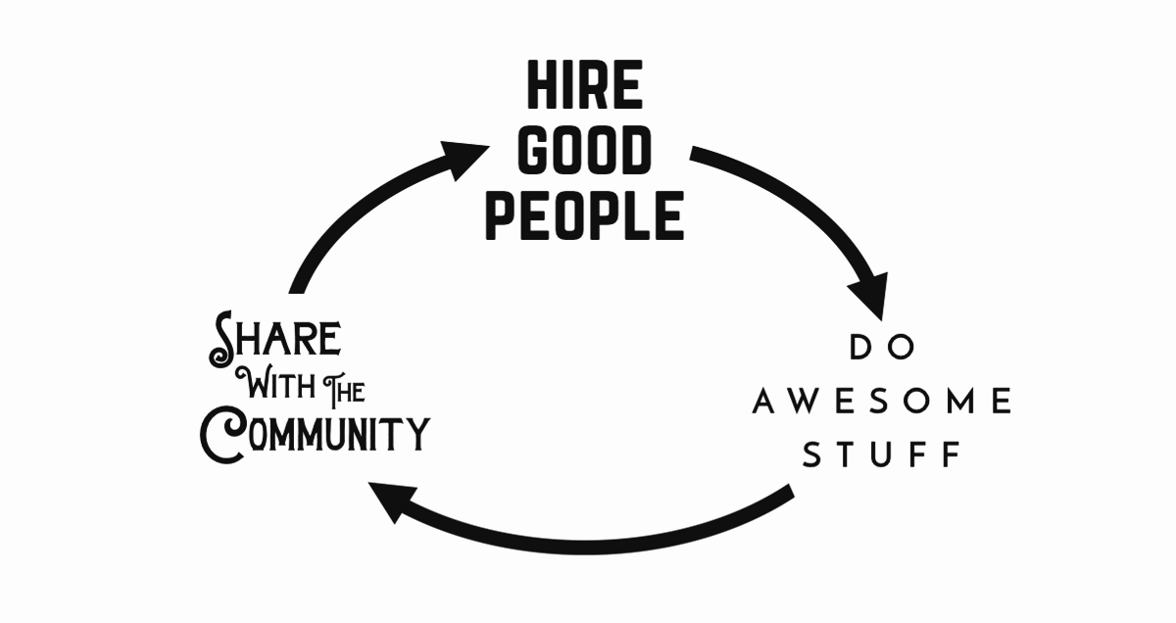
@missgeeky
Notes:
Jukesie

Slide 45
Play to your strengths.
If you can’t compete on salary talk about other benefits. Not the foosball or the game nights. The challenge. The mission. The team.
@jukesie
Notes:
Jukesie

Slide 46
Better a hole than an a$$hole
Be willing to wait.
There is often pressure to fill a vacancy. Waiting for the right candidate rather than the available candidate saves time in the long run.
@jukesie
Notes:
Jukesie It matters that you get the right person for the role. I’m talking about ‘fit’ and various biases - but genuinely, don’t hire because you’re desperate. You have to trust this person to do the job. Needing support and development is absolutely fine, but if you can’t let them do the role, you’re actually making more work for yourself.
For the Civil Service, it generally takes a year to exit someone from a role,

Slide 47

..but once you find the right person you have to move fast.
@jukesie
Notes:
Jukesie

Slide 48

If you post it they will (not) come
@jukesie
Notes:
Jukesie

Slide 49
The public service internet
jobs newsletter
Notes:
Jukesie

Slide 50
Take interviews seriously.
Use consistent questions. Never interview alone. Agree with other interviewer what you are looking for in a successful candidate. Specialist interviewers for specialist roles.
@jukesie
Notes:
Jukesie Remember: its a two way process; they’re interviewing you too.
As a bare minimum, no single gender panels and always have a mix of ethnicities.
In general I’ve found that BAME networks or similar groups within the workplace understand why you’re asking for their help and will get involved. It’s the world’s most awkward thing asking for someone to help you because of the colour of their skin; but it’s way more awkward having team isn’t diverse.
Standardise your interview questions - and agree the basis of your marking beforehand

Slide 51
Publish
Your diversity stats, your ethics, the stages of your application process. Make it open.
@jennyvass
@jennyvass
Notes:
JENNY Work in the open, blog. Hold yourself to account, share the process.
Talk about what you’re trying to do as an organisation
Hold yourself accountable

Slide 52
Think about barriers.
If you’re serious about building a good, diverse team, consider what their barriers may be.
@jennyvass
@jennyvass
Notes:
JENNY
What barriers are you accidentally or deliberately putting in place of good applicants
The there’s a department I know at a hospital only accepts doctors who have academic PhDs (as well as the obvious doctor qualifications). That automatically means you’re only going to get people who have had certain opportunities, maybe funding, and it might (if we were to make some assumptions) also mean you’re more likely to get people who are used to working in isolation. When as a patient, I really want someone with great patient skills and a high level of practical knowledge.
Going back to competencies; I have never once seen a non- Civil Servant understand how to do competencies without a bit of coaching. Think about what you’re asking for and what that will produce.
At interview you want to put your candidates at ease, so you get the best from them.
Have any of you thought about who the first person the interview is going to come into contact with is? For us and for most government buildings, it’s the security guard. And for many people, this is not a positive association. It may put them on edge, right before they need to perform.
The light chit chat when you arrive is really important; putting them at ease. Try to raise a smile,
talk to them about what to expect, explain why you’re now going to wander off into the building to find the only meeting room available.
And that links back to my last; share, talk about your organisation, your culture, so people can anticipate

Slide 53
Live your values
The bottom line: work in the open, share, support other organisations, be a place people want to work
@jennyvass
@jennyvass
Notes:
JENNY
It’s world book day, so I’m going to quote the twits “A person who has good thoughts cannot ever be ugly. You can have a wonky nose and a crooked mouth and a double chin and stick-out teeth, but if you have good thoughts they will shine out of your face like sunbeams and you will always look lovely.”
Roald Dahl, The Twits
Build a place people want to work
Think about how you create an environment where everyone is comfortable and able to be themselves
If you’re hiring for diversity, think about how you make a space and have behaviours that mean people want to be there
Have a micro-aggressions policy
Have work patterns that work for people
Publish your diversity stats
Open up your organisation: host events, blog - be a company people know and like so that people want to work for you

Slide 54
Hypothesis
Symptoms
Treatment
Follow-up

Slide 55
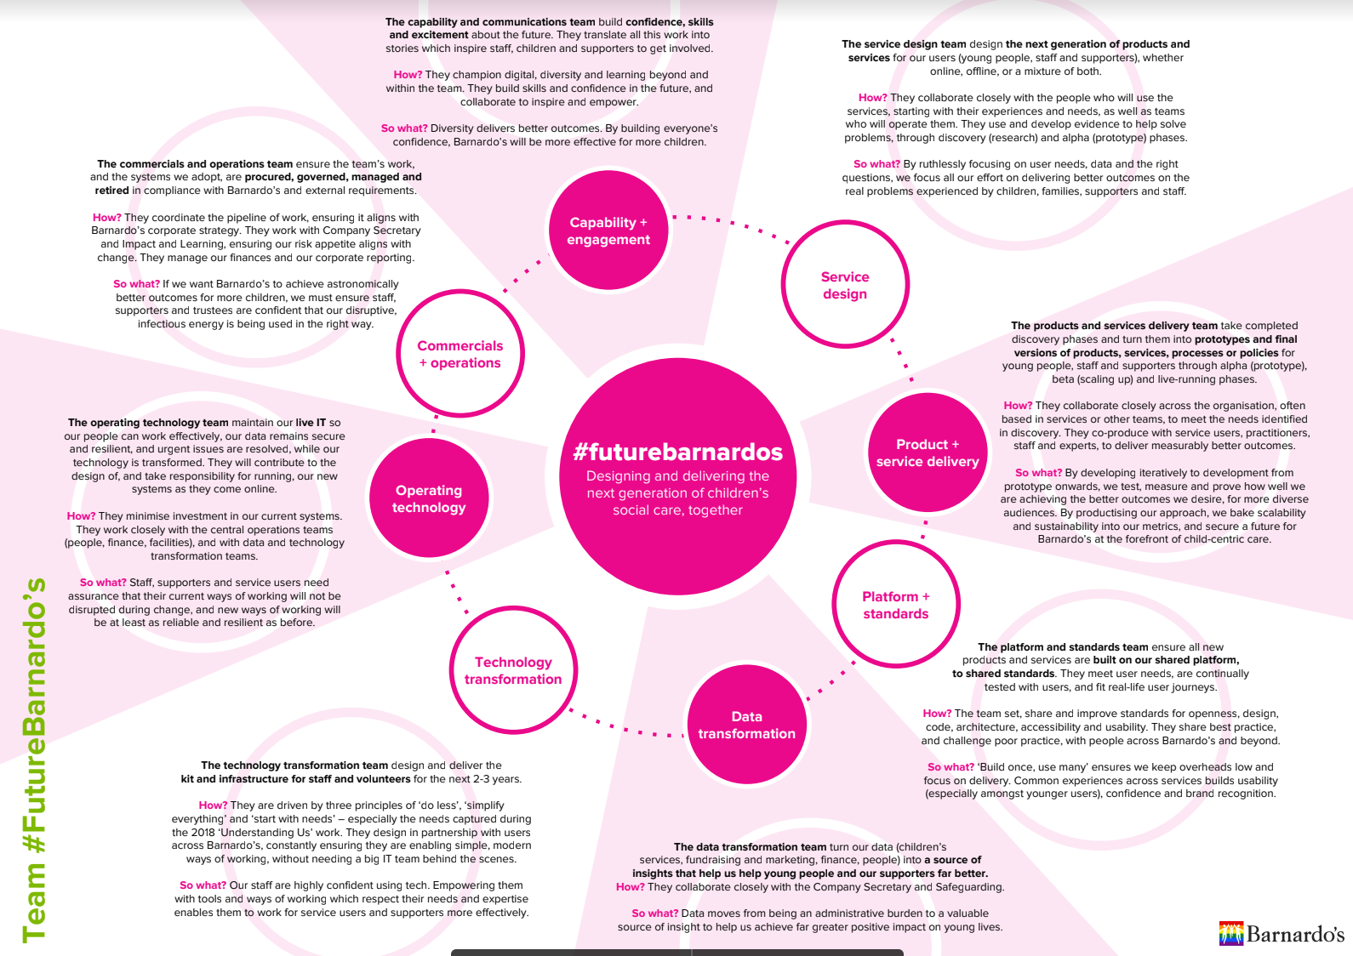
@jukesie
Notes:
https://blog.barnar.do/its-time-9485469fd956

Slide 56
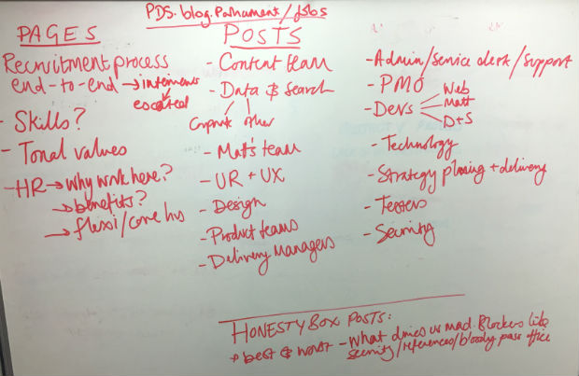
@jukesie
Notes:
https://pds.blog.parliament.uk/2017/01/31/trying-new-things-and-making-recruitment-better/

Slide 57

Questions?

